Slide 1
DIGITAL PORTFOLIO
NAME : ARUNACHALAM R
NMID : 6EFAAE3998ACAD7A31D46C72D963505B
DEPARTMENT : INFORMATION TECHNOLOGY
COLLEGE : GOVERNMENT ARTS AND SCIENCE COLLEGE,GUDALUR,BHARATIYAR UNIVERSITY

Slide 2
PROJECT
ARUNACHALAM PORTFOLIO

Slide 3
AGENDA
PROBLEM STATEMENT
PROJECT OVERVIEW
END USERS
TOOLS AND TECHNOLOGY
PORTFOLIO DESIGN AND LAYOUT
FEATURES AND FUNCTIONALITY
RESULTS AND SCREENSHOT
CONCLUSION
GITHUB LINK

Slide 4
Problem statement
• Clearly define the issue or gap your project aims to address • Describe the challenges or pain points faced by users. • Why this problem is significant and worth solving. • Example “Many freelancers lack an easy way to showcase their skills and projects, making it harder for them to attract clients.”

Slide 5
Project overview
Provide a concise summary of your project
• Describe what your project is and its main purpose • Give an overview of its scope (what it covers and doesn’t cover) • Highlight the core idea behind your work.

Slide 6
End users
• Identify the intended audience or users. • Who will benefit from this project? • How will they use it? •Example: Students, freelancers, recruiters

Slide 7
Tools and technology
List and briefly describe the tech stack used Frontend: HTML, CSS, JavaScript, React, etc. Backend: Node.js, Django, Flask, etc. Databases: MySQL, MongoDB, etc. Others: APIs, libraries, or frameworks. Mention why you chose these tools.

Slide 8
Portfolio design and layout
• Explain how you designed your portfolio
• Structure: Sections (About Me, Projects, Skills, Contact). • Aesthetic choices: Colours, fonts, Ul elements. • Layout style: Grid, single-page application, or multipage. • Responsive design and user experience focus.

Slide 9
Features and functionality
Responsive design that adapts to all screen sizes. Smooth navigation with interactive animations and effects. Project showcase with descriptions, screenshots, and external links. Option to download resume in PDF format. Social medin integration for Linkedin, GitHub, or personal blogs. Contact form with email integration or direct communication. Optional visitor analytics to track polio reach and engagement.

Slide 10
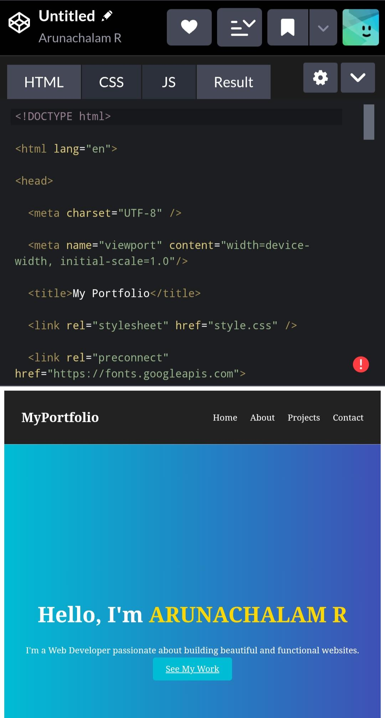
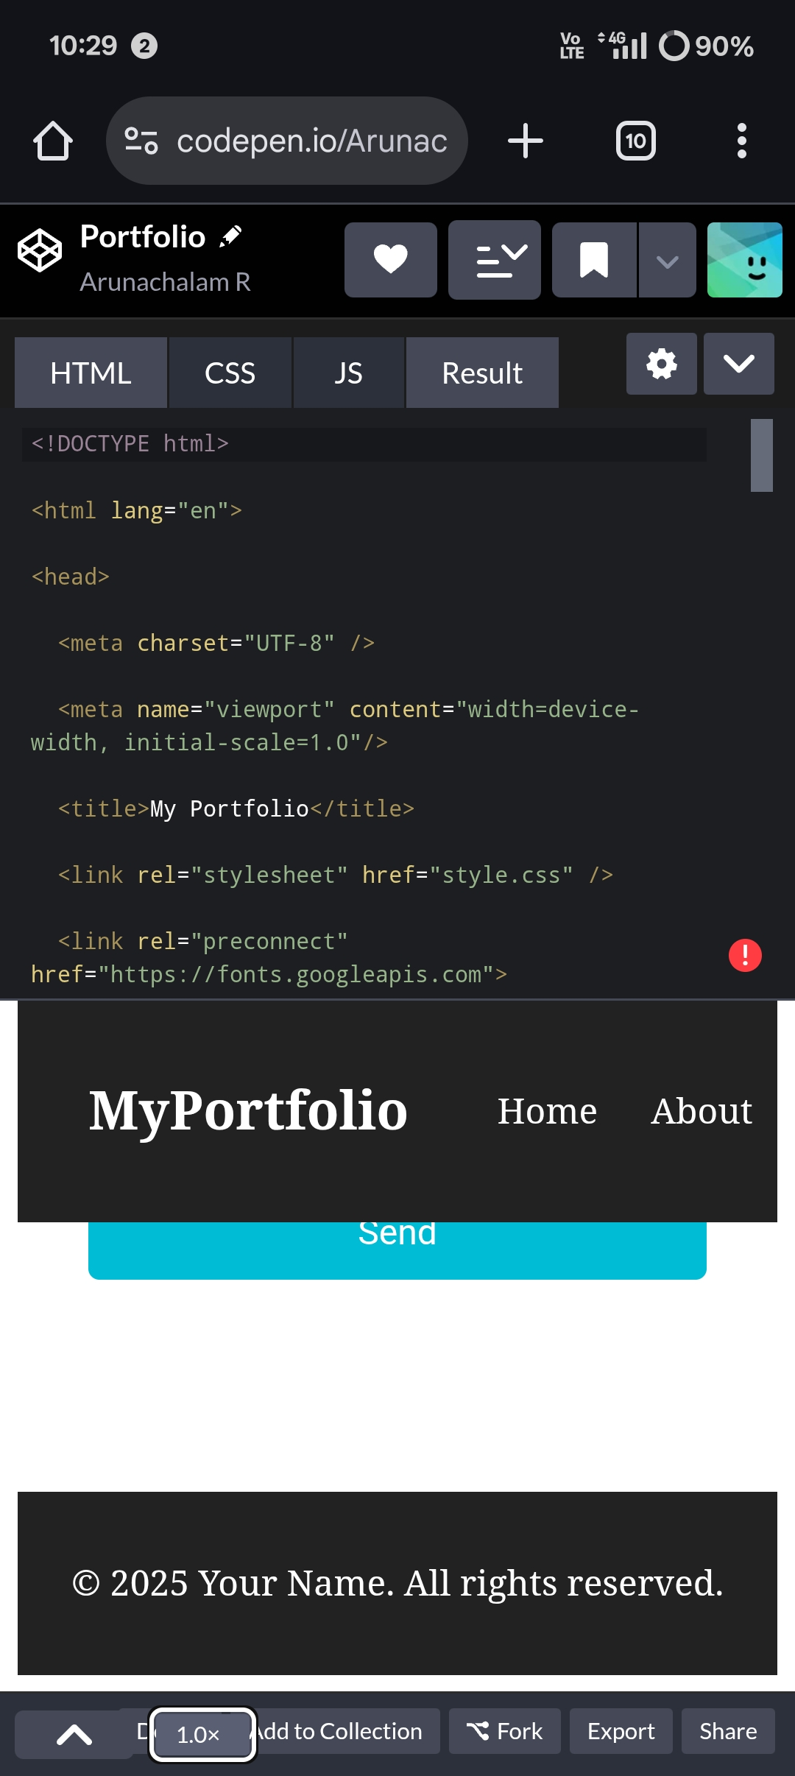
Result and screenshot

Slide 11
Conclusion
The Digital Portfolio is an effective solution for students, professionals, and freelancers to build their digital presence. By integrating modern tools, responsive design, and interactive features, the portfolio not only enhances personal branding but also increases opportunities in acadranics, jobs, and freelance markets.

